Slide 1
Data Science Capstone Project
Milestone 4
Franco Paz- UPC

Slide 2
Contents
Project presentation
Questions to Answer
Initial Hypotheses
Data Analysis Approach
Technical Challenges
Detail: Entity Relationship Diagram (ERD)
Initial Findings
Deeper Analysis / Going Broader
Final Findings (Hypotheses Results)
Recommendations

Slide 3
Project presentation
Client/Dataset: SportsStats (Olympics Dataset - 120 years of data) SportsStats is a sports analysis firm partnering with local news and elite personal trainers to provide “interesting” insights to help their partners.
Objective: establish whether a correlation exists between the country of medal-winning Summer and Winter Games athletes and their age or their morphology over the years.
Such informations could be of a certain interest for anyone who want to have a better understanding of such relationship.
For elite trainers: could help to identify future talents and where they come from.
From a commercial side: could provide informations to sportswear designers and sellers to target specific countries, clothing sizes, etc.

Slide 4
Questions to Answer
Q1. Which countries were the most prolific during Summer and Winter Games over the years?
Q2. How the height/weight ratio and age of medalists is evolving through the years?
Q3. Is there any correlation between the country of medal-winning athletes and their age or their morphology?

Slide 5
Initial Hypotheses
I am expecting to see best results for highly populated and developed countries such as USA, China or Russia.
Regarding the age, talented athletes are detected earlier and earlier, which would lead to decrease the average age of medalist.
For their morphology, trainings of athletes evolved a lot over years in order to optimize their performance. Different morphologies are expected compared to the past.
I suppose that medalists of many (or all) countries are within same ranges of ages or morphologies.

Slide 6
Data Analysis Approach
Relationship between country of athletes and the year of Winter or Summer Games.
The age and height/weight ratio averages will be also studied.
Statistics will also be used by evaluating minimum, maximum or average of data, as well as more advanced technics such as Pearson correlation coeﬃcients
Data visualization with line plots, heatmaps, etc.
Tools: Jupyter Notebook, SQL (Pandasql library), Python libraries

Slide 7
Technical Challenges
Encountered challenges with data visualization for representing large amount of data when establishing the relationship with countries
Limitations of Pandasql Python library to execute SQL commands

Slide 8
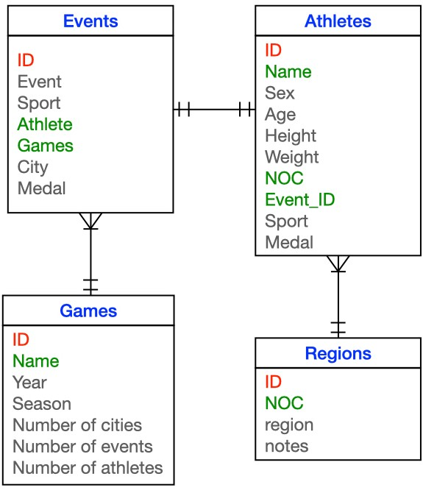
Entity Relationship Diagram

Slide 9
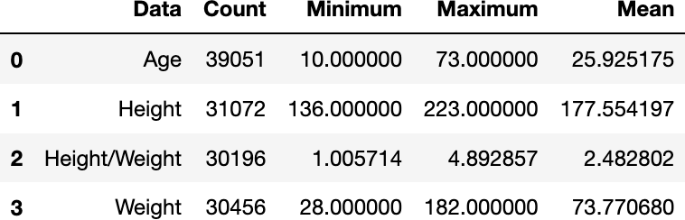
Initial Findings
Contains null-data
In average, medalists are of medium size (mean 177.55) and weight (mean 73.77), with an average ratio of 2.48. They are also relatively young (mean 25.93).

Slide 10
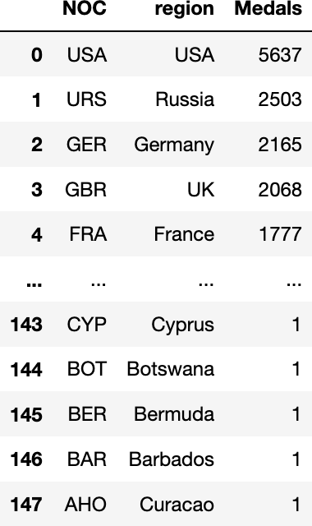
Initial Findings
The fifth first ranked countries are developed countries but also highly populated (so statistically a higher number of athletes)
In contrast, the fifth last ranked countries correspond to small countries with a rather small number of citizens (so statistically a lower number of athletes)

Slide 11
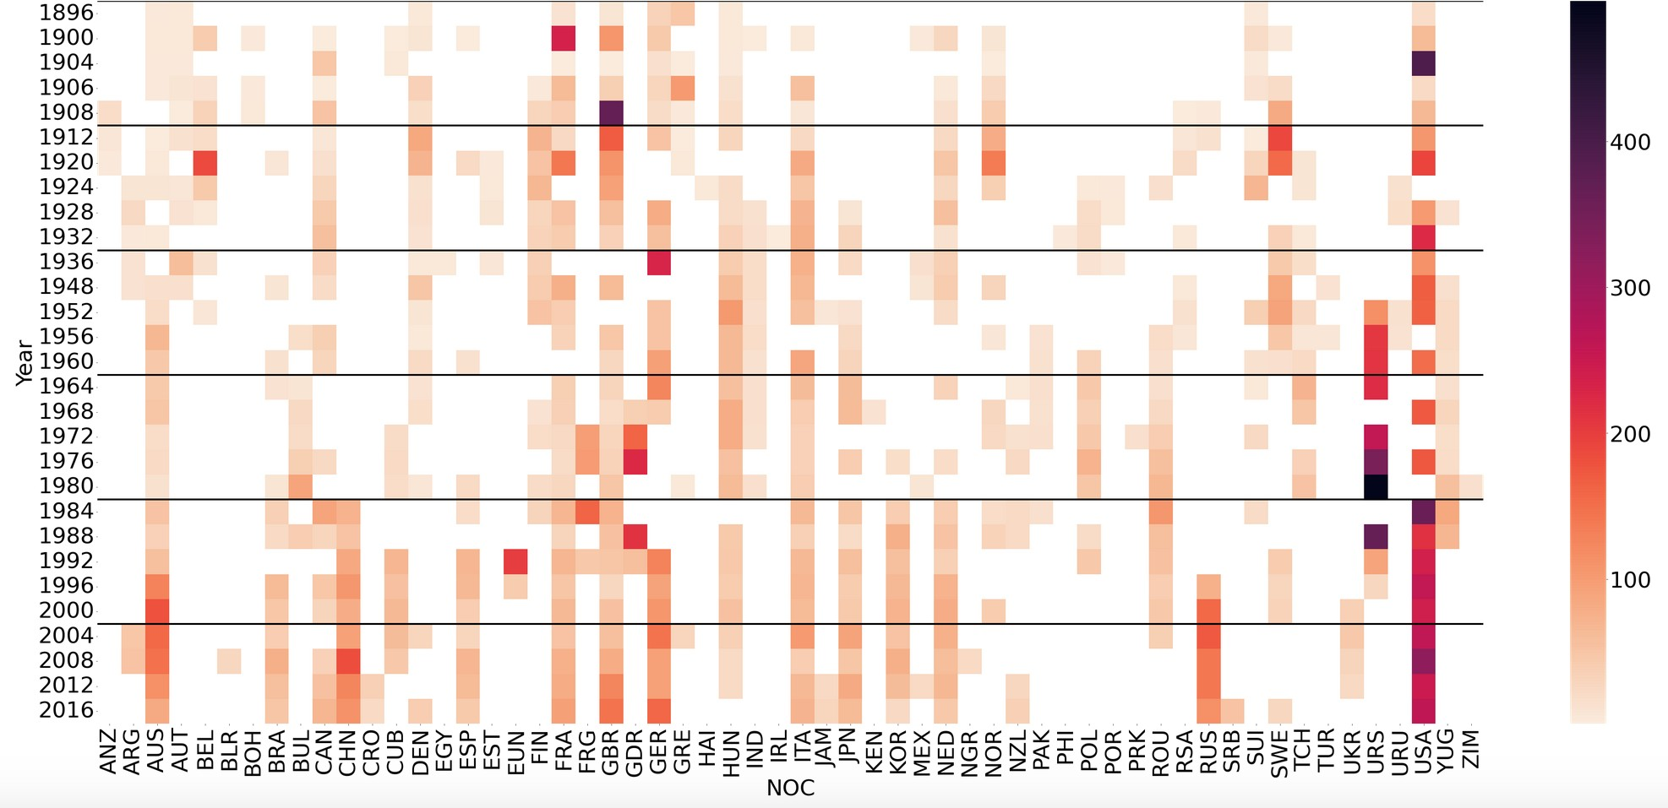
Initial Findings
USA dominates the Summer Games for more than 40 years.
For 20 years, USA are followed by some European nations (Germany, France, UK, Italy, etc.) as well as Asian nations (Russia, China, Japan, etc.) or Australia.
From the 50s to 70s, these Games were dominated by ex-URSS.
# Medals in Summer Games
1st Hypothesis

Slide 12
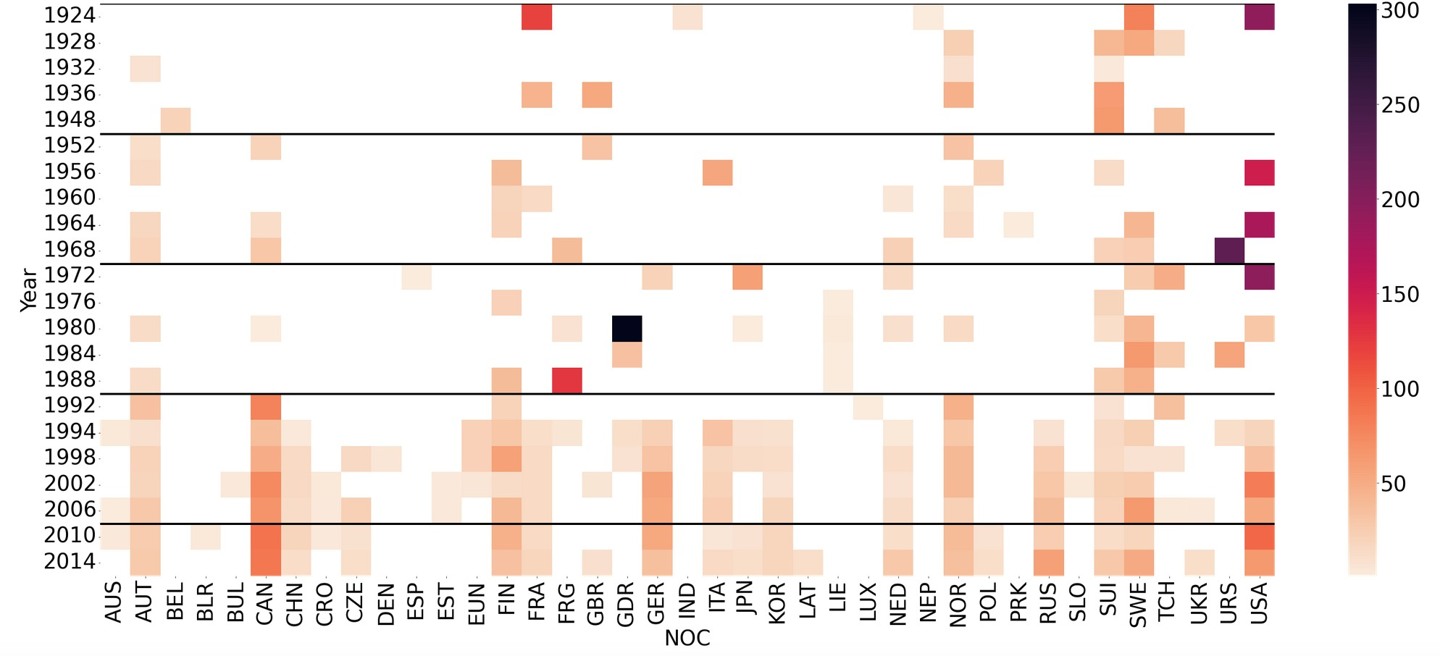
Initial Findings
USA also mainly dominates over the years, followed by Canada since 1992.
Again, Russia (and ex- URSS) shown some medals, but most of time less important than Nordic countries such as Sweden, Norway or Finland.
1st Hypothesis
# Medals in Winter Games

Slide 13
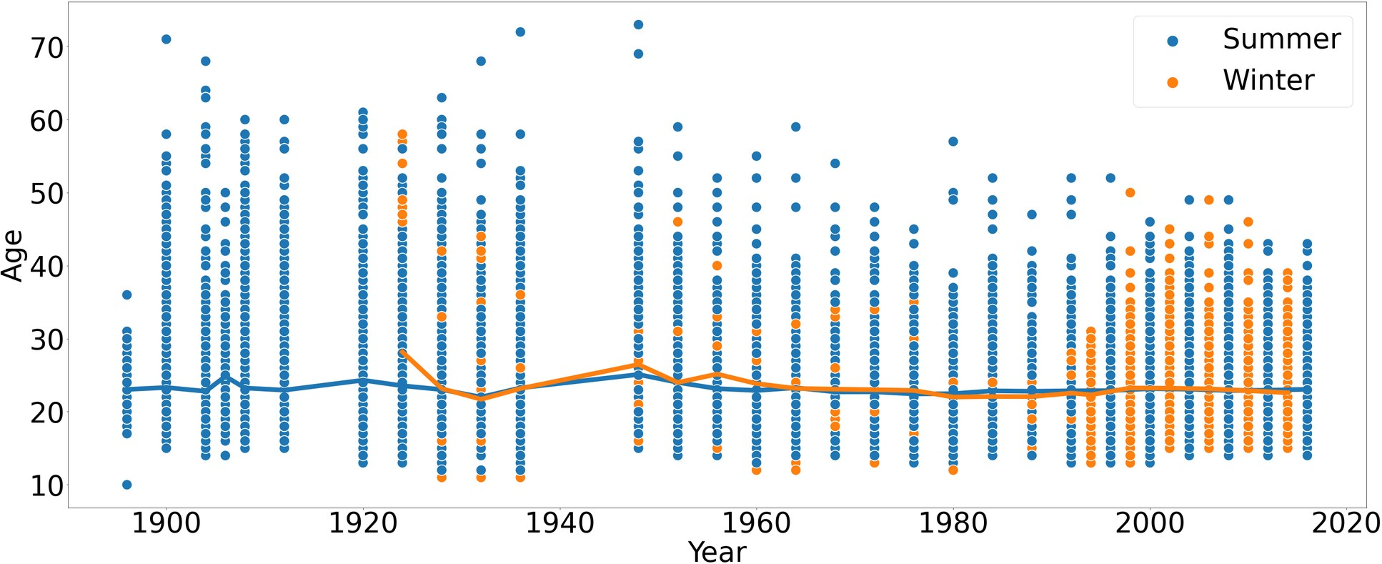
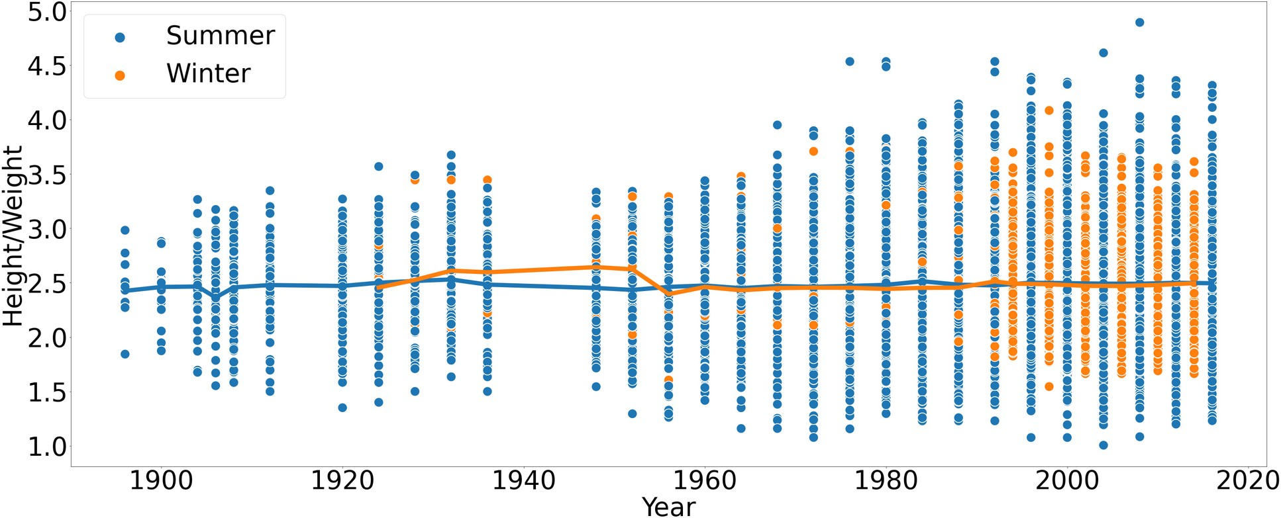
Initial Findings
Mean age of medalists is near 25, while the distribution of data is wider for oldest years than closest years.
Could be interesting to correlate it with the nature of sports.
Mean appears more or less constant over the years and whatever the season is, around 2.5 which is a "regular" ratio.
In contrast, the distribution of data is wider for closest years than oldest years.
Could be interesting to plot separately Height and Weight to get deeper insights.
✗ 2nd and 3rd Hypotheses

Slide 14
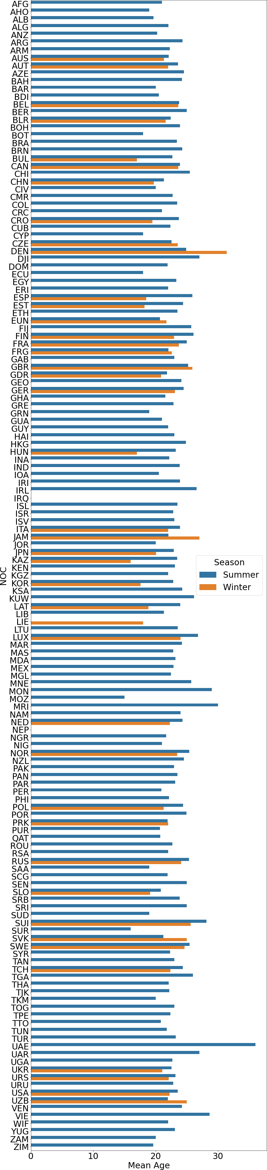
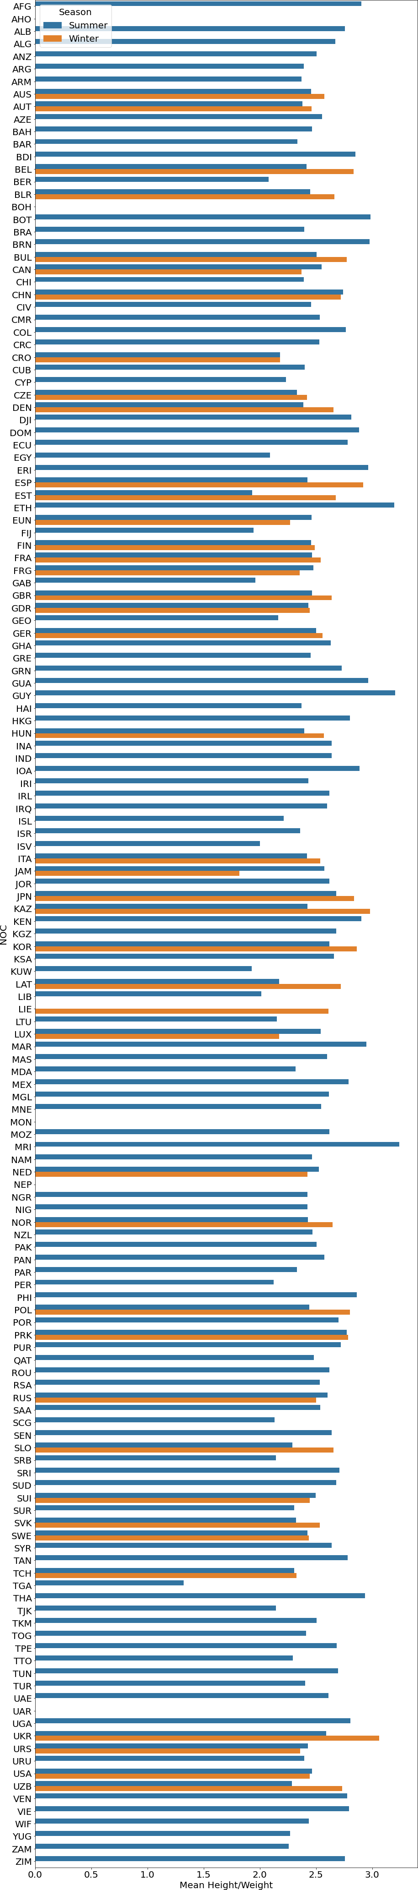
Initial Findings
Most of the countries show same behavior with medalists ranging between 20 and 25 years old, whatever the season is.
Most of countries show same behavior with medalists with a mean Height/Weight ratio arount 2.3-2.5, whatever the season is.
4th Hypothesis

Slide 15
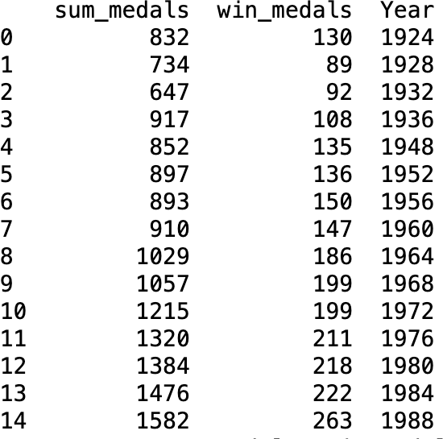
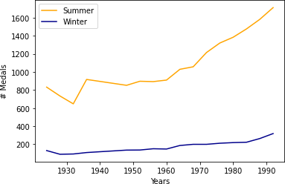
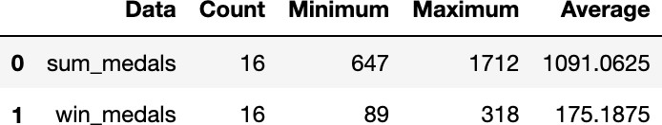
Deeper Analysis
Correlation between the total number of medalists in the Winter and Summer Games.
Pearson corr. coef. = 0.960
High correlation of performances in both seasons

Slide 16
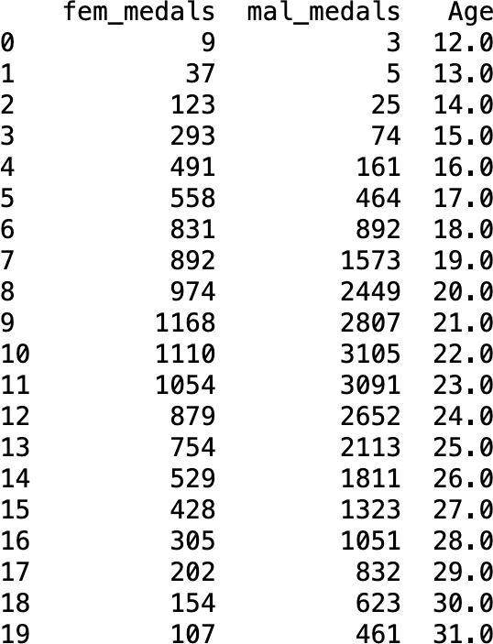
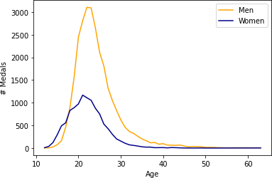
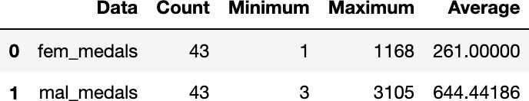
Going Abroad
Correlation between the total number of women and men medalists for given ages
Pearson corr. coef. = 0.924
Good correlation of performances for both sexes

Slide 17
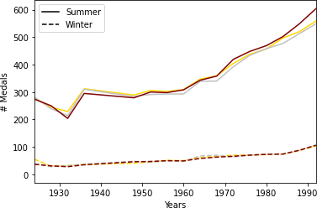
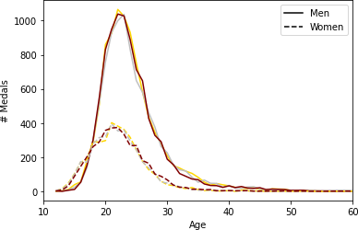
Deeper Analysis / Going Broader
New metric: total number of bronze, silver and gold medals; allows to more finely inspect similarities in both situations, because of the introduction of the rank.
Confirms high correlation in both cases
Pearson corr. coef. | Summer vs Winter / Years | Men vs Women / Age
Gold medals | 0.943 | 0.918
Silver medals | 0.937 | 0.917
Bronze medals | 0.973 | 0.930

Slide 18
Final Findings (Results of Hypotheses)
✓ Best results for highly populated and developed countries such as USA, China or Russia.
✗ The average age of medalist is constant over the years
✗ The average of morphologies is constant over the years
✓ Most of countries have medalists within same range of ages or morphologies.

Slide 19
Recommendations
The average age and morphology of medalists being the same between countries, I would suggest to sportswear sellers that clothes do not have to present specific sizes or mensurations depending on the country.
Nordic countries show logically good performances during Winter Games. I would advise concerned elite trainers to take more informations on those countries (their technics, etc.).
To complete this analysis, it would be interesting to go deeper by distinguishing categories of sports. That could enable to find new correlations (more specifically with the morphology of medalists).

